Slide 1
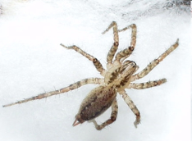
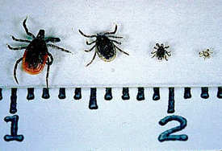
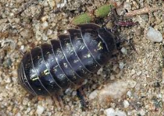
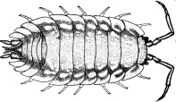
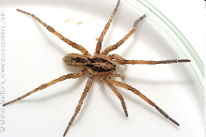
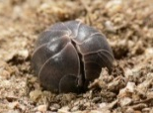
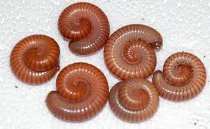
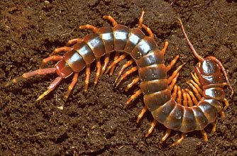
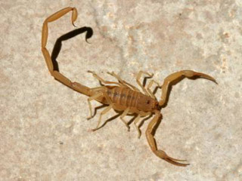
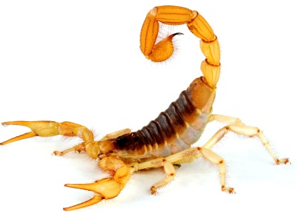
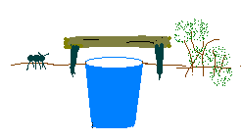
♦ Arthropods of the BOSQUE ♦
Class: Crustacea
Order: Isopoda – pillbugs or roly polys & sow bugs or woodlice
Class: Arachnida
Order: Araneae - spiders
Class: Arachnida
Order: Acarina- ticks and mites
Class: Diplopoda - millipedes
Class: Diplopoda - millipedes
Class: Arachnida
Order: Scorpiones – scorpions
Taxonomy
Kingdom: Animalia
Phylum: Arthropoda
Common characteristics
Jointed Legs
Exoskeleton
Segmented Body

Slide 2
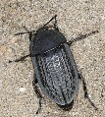
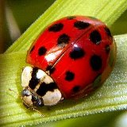
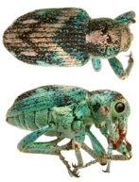
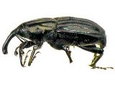
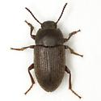
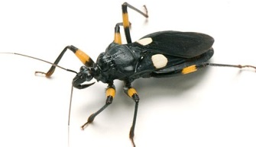
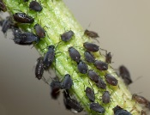
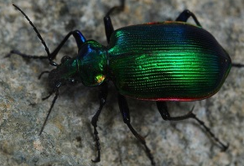
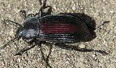
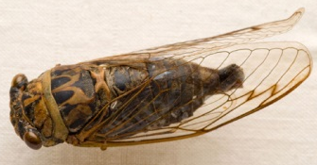
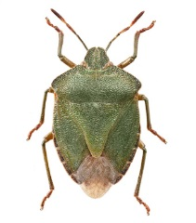
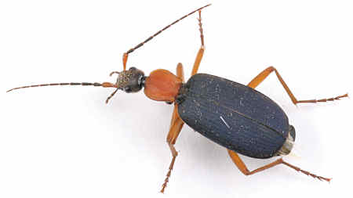
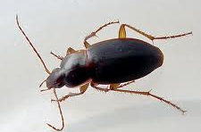
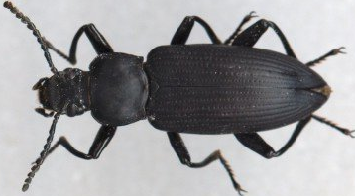
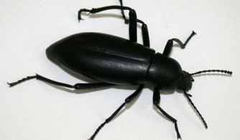
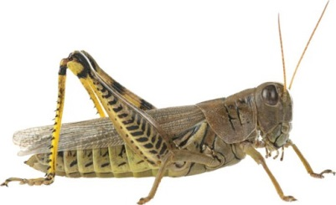
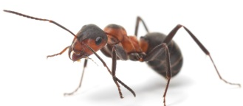
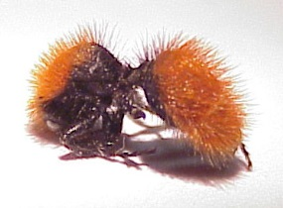
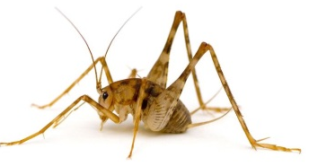
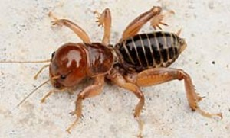
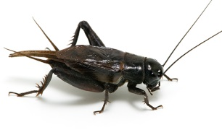
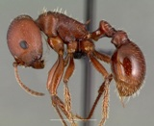
♦ Arthropods of the BOSQUE ♦
Class: Insecta
Order: Coleoptera - Beetles
Family: Silphidae
– carrion beetles
Family: Staphylinidae
- Rove beetle
Family: Coccinellidae
- Ladybird beetle
Family: Cicindelinae
- Tiger beetle
Family: Curculionidae
- Snout beetle (weevil) Tiny! 1-5mm
Order: Hemiptera - True Bugs (cicadas, aphids, shield bugs, assassin bugs)
Family: Carabidae – Ground Beetles (found in moist areas)
Family: Tenebrionidae – Darkling Beetles (found in dry areas)
Order: Hymenoptera – wasps, bees, ants
Family: Formicidae
- Harvester ant
Family: Mutilidae
- Velvet ant
Order: Orthoptera – grasshoppers, crickets & other groups
Camel cricket
Jerusalem cricket
Grasshopper
Field cricket

